Slide 1
Helen 7
Outreach Team
Notes:
M

Slide 2
Notes:
LYNNE
This is Samaritans’ vision – that fewer people die by suicide.

Slide 4
In England
4,912
people took their own life in 2020

Slide 5
Your local branch
Norwich Samaritans have been supporting Norwich and our surrounding footprint for 56 years.
Every year, c.200 volunteers give over 25,000 hours to support those struggling to cope.
In 2020, we:
took over 18,000 calls for help
spent 5½ thousand hours on the phone
replied to nearly 3,000 emails
took part in a national pilot for online chat

Slide 6
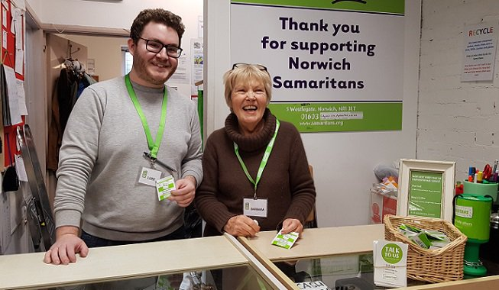
Your local branch
As well as delivering our listening service, we support HMP Norwich and HMP Bure by training prisoners to provide emotional support to their peers.
We also have two charity shops that help us to raise funds and awareness of our service in the local community.

Slide 7
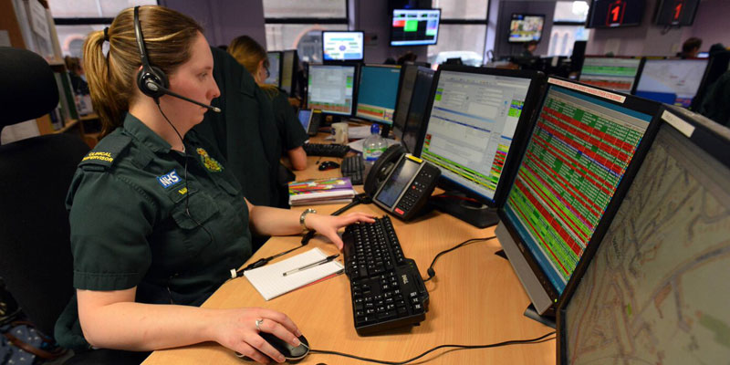
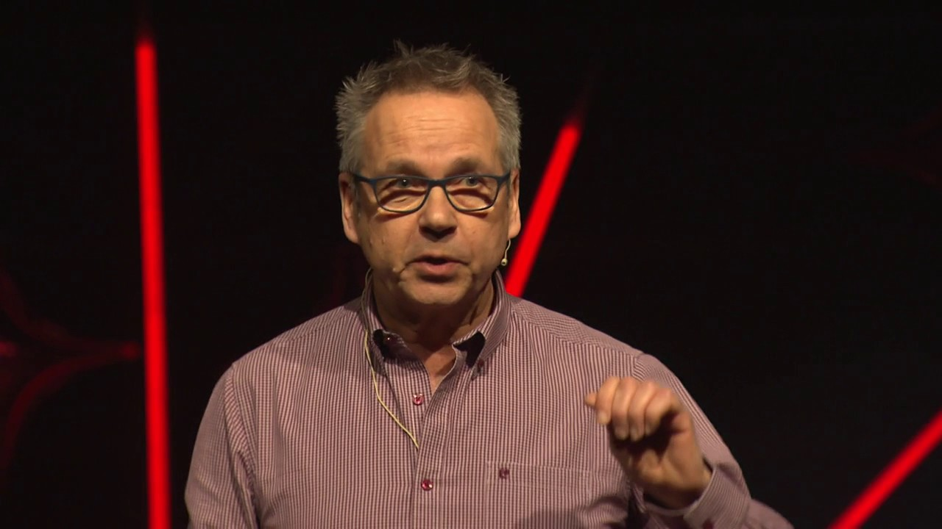
Outreach

Slide 8
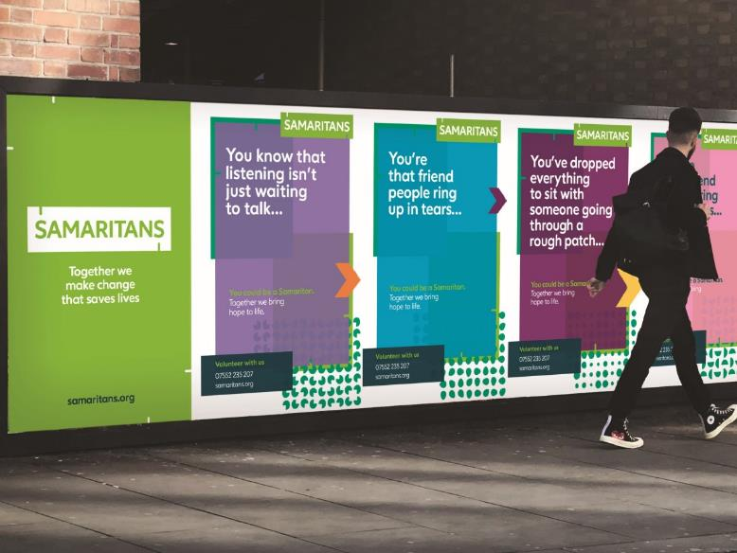
Notes:
Coronavirus is impacting all of our lives, with many people feeling anxious and stressed. There’s no doubt that these uncertain and challenging times can affect our mental health and wellbeing.
Samaritans is a critical service, needed now more than ever.
Although we are physically isolated from one another, it is more crucial than ever to remain socially connected.
Samaritans is busy 24 hours a day, 365 days a year and this hasn’t changed during the pandemic. In the six months of restrictions since March 2020, our volunteers have provided emotional support more than 1.2 million times by phone, email or letter.
That support is for people feeling concerned about all assorts of things - mental health and illness, family relationships, finance and unemployment, loneliness and isolation and of course coronavirus itself.
The ways in which callers talk about coronavirus have evolved since restrictions were imposed – from being related to the risks and effects of being exposed to the virus, to being focused on the economic, social, and mental health-related impacts of lockdown and social distancing measures.
Our research shows that the pandemic and the ongoing restrictions have particularly impacted three groups of people at an already high risk of suicide: middle aged men, young people and people with pre-existing mental health conditions.

Slide 9
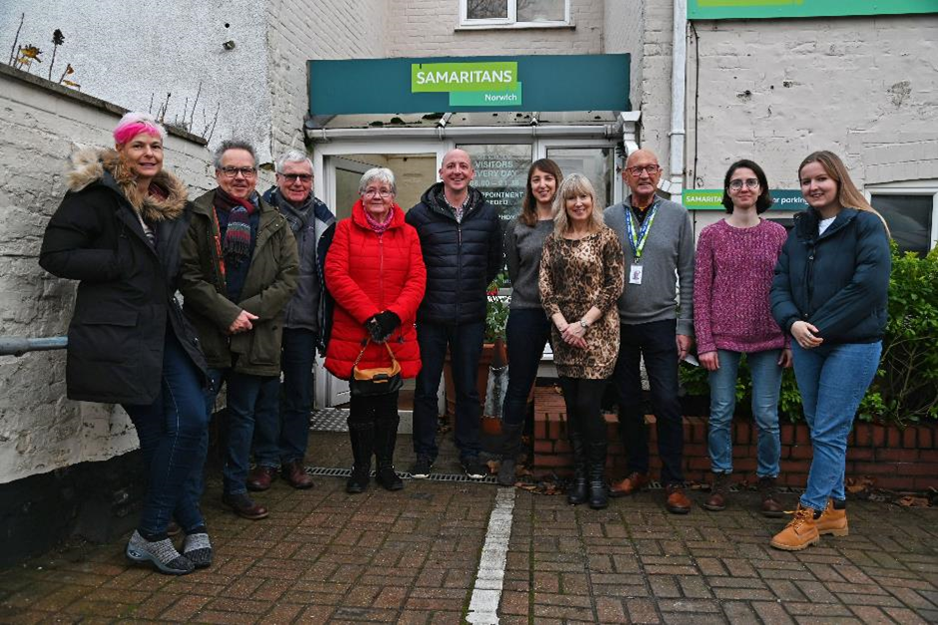
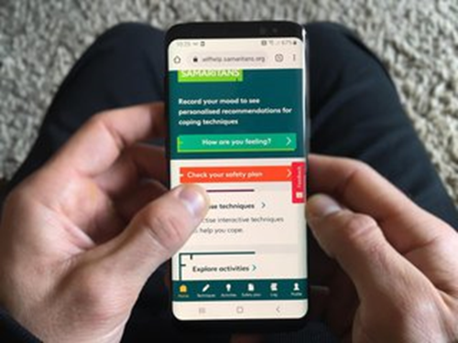
A Samaritan’s shift
42 shifts a year, with 10 of these being night shifts
3, 4 or 5 hours
Always with at least one other, for support
Via: phone calls, emails and online chat
There is also an app:

Slide 10
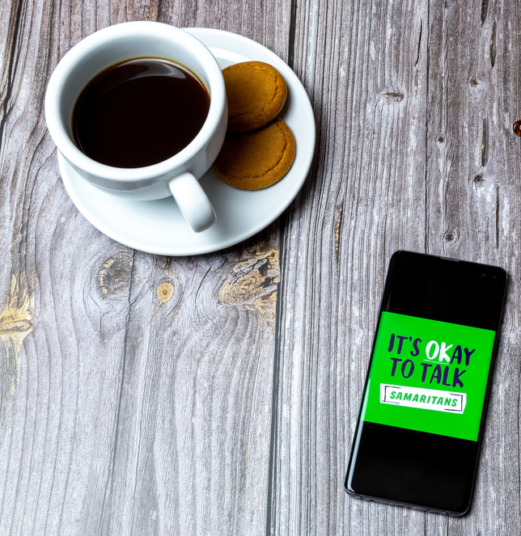
A Samaritan’s shift
At the end, “offload” to Leader, by phone:
Every call
Leader provides emotional support
Samaritan then shreds notes
SO important.
This is how we 'leave it all behind'.
During a shift, we will also check on colleagues, offer to make a cup of tea, etc.

Slide 11
How we listen
Notes:
MARTYN
Once someone starts to share how they’re feeling, it’s important to listen.
This could mean not offering advice, not trying to identify what they’re going through with your own experiences and not trying to solve their problems.
We’ve compiled some listening tips to help you give the best support you can. And we’ve used an acronym to help you remember – we all like an acronym. I’ll take us through the five points one by one.

Slide 12
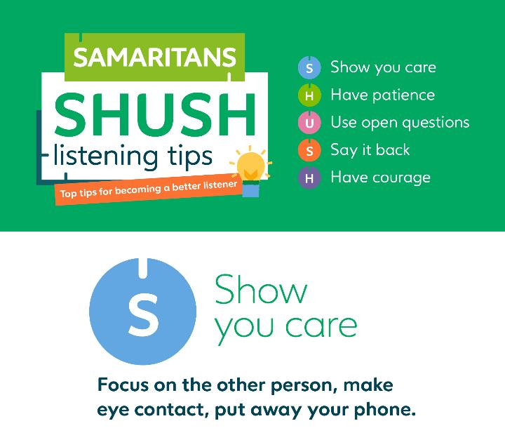
Notes:
MARTYN
Here’s the “S”. “S” stands for “Show you care”.
To really listen to somebody, you need to give them your full attention, maintain eye contact and be engaged.
Getting into this habit takes practice so don’t be too hard on yourself and keep using these handy tips:
When starting the conversation, resolve not to talk about yourself, at all.
Keep a listening diary - just for a week. Record how many times you listened really well, note what challenges and distracts you and what you think went well.
Aim to learn at least one new thing about the person who is talking to you.
In summary, show you care, focussing on that other person.

Slide 13
Notes:
MARTYN
“H”. Have patience.
Effective listening is about creating trust with the other person. The person sharing shouldn’t feel rushed, or they won’t feel it’s a safe environment.
So, if they've paused in their response, wait. They may not have finished speaking. It might take them some time to formulate what they are saying, or they may find it difficult to articulate what they're feeling.
Through non-judgemental listening, you are allowing the person to relax into the conversation and to use it as a place to reflect or work through difficult emotions.

Slide 14
Notes:
MARTYN
The “U” – Using open questions.
An open-ended question means not jumping in with your own ideas about how the other person may be feeling.
These questions don't impose a viewpoint and require that person to pause, think, and reflect… and then hopefully expand.
Avoid asking questions or saying something that closes down the conversation. Open-ended questions encourage them to talk, the conversation is a safe space that you are holding for them and nothing they say is right or wrong. Try asking, 'how are you feeling today’?
I feel this could benefit from some examples. Basically, a closed question is one which leaves the answerer nowhere to go, so most likely there is a simple Yes or No answer. An open question might begin with “Tell me about…”, or “What is it about…?” Some apparently closed questions CAN work, if they open up an obvious subject for the answerer. I like to give the example of asking a football fan: Who was better, Messi or Zidane? It seems at first signt that it will be answered in one word, but in actuality you will have tapped into a range of feelings and opinions that will open up a conversation.

Slide 15
Notes:
MARTYN
The second “S” – Say it back.
Check you’ve understood, but don’t interrupt or offer a solution.
Repeating something back to somebody is a really good way to reassure them that they have your undivided attention. And you can check to see that you’re hearing what they want you to hear, not putting your own interpretation onto the conversation.

Slide 16
Notes:
MARTYN
The final “H” – Have courage.
Don’t be put off by a negative response and, most importantly, don’t feel you have to fill a silence.
Sometimes it can feel intrusive and almost counter-intuitive to ask someone how they feel. You’ll soon be able to tell if someone is uncomfortable and doesn’t want to engage with you at that level.
You'll be surprised at how willing people are to open up, and how, sometimes, it is exactly what somebody needs to be able to share what is going on their mind.

Slide 17
How to be a good listener
Make eye contact and put away your phone.
Focus completely on the other person.
Pauses are fine, try not to jump in to fill a silence.
Say back what you think it is they are wanting you to hear.
Resist putting your interpretation on it.
Don’t give up. Sometimes it can take a few tries.
Notes:
MARTYN
Here’s a summary of some of the key things to remember about how to be a good listener.
Remember to keep eye contact – so, put that mobile phone away!
Your focus should be entirely on the other person.
If the conversation goes quiet, wait before jumping in again.
Play what you’ve heard back to the other person, as a way of checking it is what they wanted you to hear.
Try not to add in your own experience or take on the conversation.
And keep at it. You may need to persevere.

Slide 18
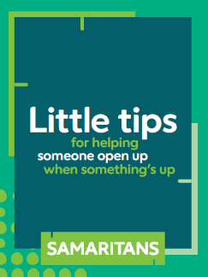
How to open up a conversation
Choose a good time, and somewhere without distractions.
Use open questions that need more than a yes/no answer.
‘How are things? I’ve noticed you don’t seem quite yourself.’
Listen well. ‘How’s that making you feel?’
Avoid giving your view of what’s wrong, or what they should do.
Notes:
MARTYN
Here are some tips on helping someone open up when something’s up.
Try to find a time when you won’t be disturbed, or distracted.
Remember that use of open questions, rather than those which can be answered with a simple Yes or No.
Like “How are things?”, maybe followed by something that suggests you care.
Show you’re listening by asking questions occasionally, such as how something is making them feel.
And try not to add your own view into the conversation, or give actual advice.

Slide 19
Self-care when supporting others
You can't pour from an empty jug-treat yourself with kindness and compassion
If you're under a lot of stress it can affect your judgement- it's important to have a SAFETY NETWORK
Take time for yourself to recharge and refill
Give yourself time to process the experience and talk about your feelings

Slide 20
Managing your emotions and reactions
It's not easy to put your own feelings aside which can lead to a loss of perspective or control of the situation
Be aware of how you react and of pushing aside your own emotions
Suppressing emotions, especially grief, stress or anger can have consequences later on
Take note of your feelings and find ways of dealing with them in your own time
Talk to another person you trust
Give yourself time to do something you enjoy

Slide 21
Try to build up a support network
No one can give another person everything they need, especially through difficult times
It's important to manage your own expectations too, otherwise you might feel you're letting them down or failing
You can share a person's worries without taking their burden on your shoulders

Slide 22
Self-care
Learning to listen to ourselves is the first step to being a better listener
Name the feelings
Listening to our bodies and knowing/doing what we need to do when exhausted or stressed to ensure we give ourselves the time out to reflect
Surround yourselves with a team

Slide 23
Self check-in
Signs you may recognize that might mean you want to talk to someone can include:
Thoughts and images
Thinking styles (rumination/repetitive thoughts/catastrophizing)
Changes in mood
Feelings of shame or guilt
Changes in behaviour e.g. sleep. tearfulness

Slide 24
Practice well-being
Keep to a regular routine
Sleep well
Eat healthily
Exercise
Reward yourself for any achievements
Find something that helps you relax
Take time to enjoy the moment and the environment around you

Slide 25
Notes:
MARTYN
Importantly, if you know or speak to someone who needs our help, please signpost them to us.
Did you know, you don’t have to be feeling suicidal to call Samaritans?
Samaritans is free and open 24 hours a day for anyone feeling low or worried too.

Slide 26
Notes:
MARTYN
Thank you for joining this Zoom chat today to find out more about learning to listen.
Lynne and I are now very happy to take questions.

