Slide 1
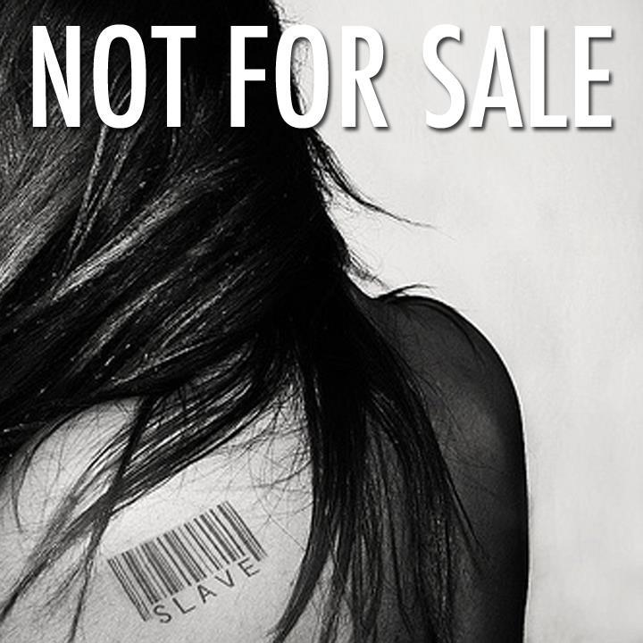
MODERN SLAVERY & HUMAN TRAFFICKING (Norfolk Adult Safeguarding Board)
Mark ENGLISH
Human Trafficking & OCG Coordinator

Slide 2
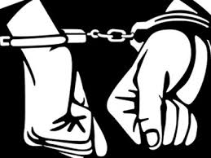
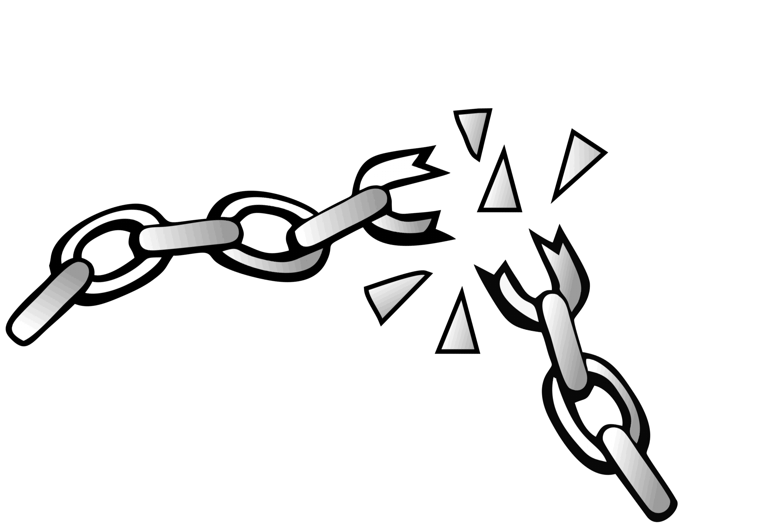
The Plan
The basics; Overview & a little law
Why do people become victims?
Signs to look out for
Where does it occur?
Help
Nb. I will be talking negatively about some people from different cultures; please recognise that this is about criminals within those cultures not those cultures themselves

Slide 3
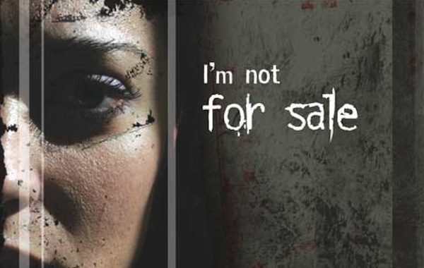
MODERN DAY SLAVERY
There are probably 100,000 victims of slavery in UK today! (Centre for Social Justice; July 2020)
It happens everywhere, even in Norfolk & Suffolk
Slavery is an abuse of Human Rights
Effects society’s most vulnerable men, women & children
Includes UK and Foreign Nationals trafficked into, out of and around the UK
2,340 victims were identified as trafficked and referred in UK during 2014, an increase of 34% from 2013
A further jump of 40% in 2015 led to 3266 people being referred. Each referral equates to a crime
Increased roughly 40% per year since; but gone down in 2020 (probably due to COVID)
Legislation; Modern Slavery Act (MSA) 2015

Slide 4
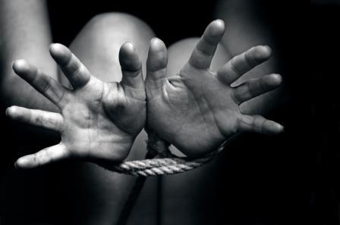
What is
Modern Slavery?
When a person is enslaved and exploited:
Forced or compelled to work, or do something they do not wish to - through mental or physical threat;
“Owned” or controlled by an 'employer', usually through mental or physical abuse or the threat of abuse;
Dehumanised - treated as a commodity, bought & sold as 'property';
Physically constrained or has restrictions placed on his/her freedom of movement.
(Sect 1. MSA 2015)

Slide 5
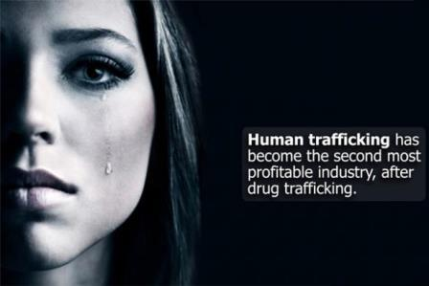
Human Trafficking Sect 2 MSA 2015
LOWER RISK
& HIGHER PROFIT
Organised Crime

Slide 6
What is Human Trafficking?
The Act (what is done) - recruitment, transport,
transfer, harbouring, and receipt of persons;
The Means (how it is done) – threat or use of force, coercion, abduction, fraud, deception, abuse of power or vulnerability, and giving payments or benefits;
The Purpose (why it is done) - EXPLOITATION
Includes: prostitution of others, sexual exploitation, forced labour, servitude, removal of organs, benefit fraud, enforced criminality, torture & slavery.
NOTE: Child victim under the age of 18 years, only necessary in prosecutions to prove "the Act" and "the Purpose" for the offence to be complete.

Slide 7
Trafficking Vs Smuggling
SMUGGLING:
Crime against the state
Involves immigrants and asylum seekers paying others to help them enter a country illegally
After the transaction there is no longer a relationship
TRAFFICKING:
Crime against the person
Victims are coerced or deceived
On arrival they are exploited

Slide 8
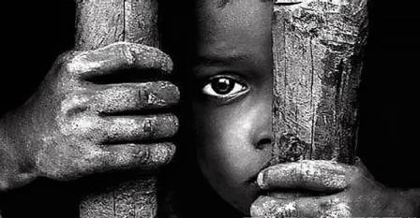
The PUSH and PULL into Modern Slavery
PUSH | PULL
Poverty | Violent Abduction
Unemployment | A job offer abroad, that pays more
Lack of food, education or medical care | Advertisement for a job overseas
Conflict or crime | Promise of marriage
A sick relative | Threats to person or family members
 | An offer of better education

Slide 9
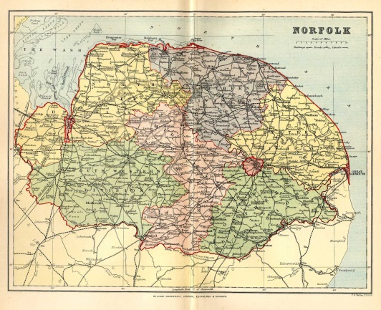
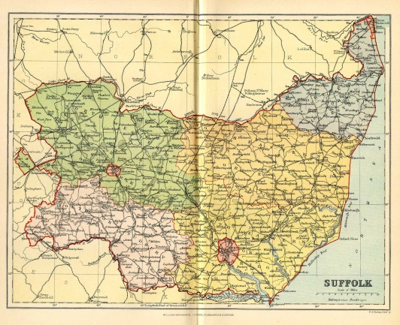
Vulnerabilities (Example)
Broken home
Learning difficulties
Mental Health issues
Peer pressure / minor crime
Age
Drink / Drugs
Homelessness
Threats
Violence
Other potential vulnerabilities
Language barriers / Immigration status / Debt

Slide 10
General Indicators
Passport / ID documents held by someone else
Controlled over movement
Bonded to debt
Excessive working hours
No or little pay
Frequently moving to different locations
Not knowing address of where they work or live
Expression of fear or anxiety and withdrawn
Physical / sexual assault / psychological trauma
Highly distrustful of Police and Authorities
Poor or sub-standard living accommodation (HMO’s?)
Not registered with GP or school
The person acts as if instructed by another / scripted
Accompanied by chaperone / interpreter (why?)
CASH

Slide 11
Houses of Multiple Occupancy (HMO’s)
An HMO is a place rented out to 5 or more families
5 individuals can count as 5 families
All HMO’s must be registered with local council but many are not
Known to be potential places of exploitation / risk /criminality
Eg. Bed hopping (COVID) / poor sanitation/ unreasonable rent/ abstracting electricity / address for fraud
Councils will deal if they know of suspected abuse

Slide 12
Lack of engagement; Why?
May not trust authorities; experience in home country of Police & authorities may not be positive
May have been briefed against Police & authorities
Think they are in trouble & liable to arrest
Threats by exploiters?
Debt bondage; do they owe money? Are they being forced to pay it back
Cannot afford to be without income
Want to remain under Radar to stay after BREXIT?

Slide 13
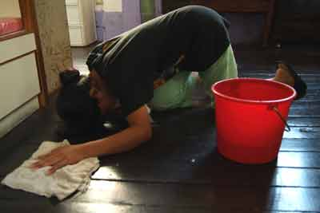
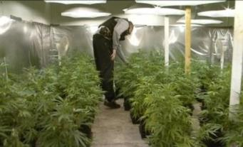
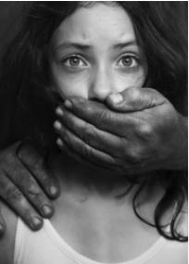
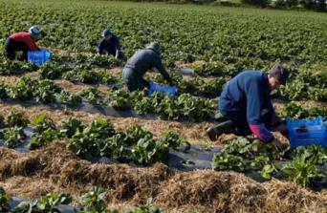
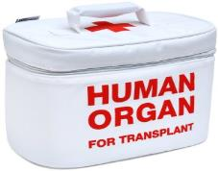
Domestic Servitude
Sexual Exploitation
Child Exploitation
Forced Criminality
Types of Modern Slavery
Organ Harvesting
Forced Labour

Slide 14
Labour Exploitation
Anywhere where there is a need for temporary labour; Eg;
On the land
Factories (inc. food production) COVID!
Car Washes
Nail bars
Construction (inc. paving)
Hospitality
Restaurants

Slide 15
Forced Criminality
County Lines
Cannabis cultivation
Benefit fraud
Shoplifting
Burglary & thefts
Making off without payment
Begging (Big issue?)
Forced marriage

Slide 16
Sexual Exploitation
Much bigger problem today than before Internet
Not an offence to be a sex worker
Most transactions / advertisements on line
Legal advertising companies inc. Viva Street; Adult work; Gumtree etc….. all tastes catered for
Does not involve kerb crawling
Large profits to be made
Project PHOENIX

Slide 17
Domestic Servitude
Tend to find offenders within 3 main cultures;
Travellers
People from Indian Sub-continent
West African
But not just there; case in Norwich with white Norfolk offenders & white Norfolk victim

Slide 18
Organ Harvesting
Not really problem in UK; only one known case in UK
Mainly kidneys……………….you can survive on one healthy kidney
Fed by obscenely rich abusing themselves and by desperation of very poor
Organ dungeons in Pakistan!

Slide 19
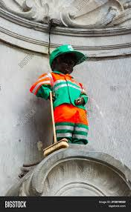
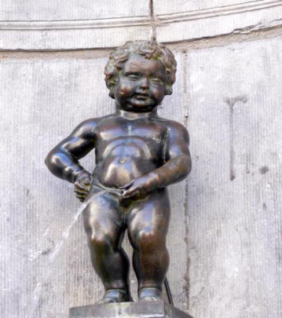
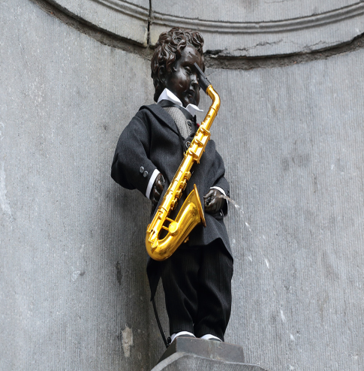
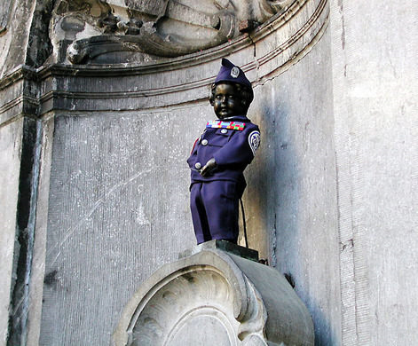
The Four P’s approach

Slide 20
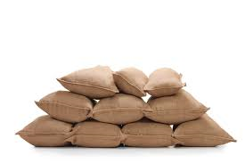
4 P’s examples
PREVENT;
Increase good practise within businesses
Disruption of OCG’s
PREPARE
Increased knowledge of all partners
Intelligence sharing
PROTECT
Safeguard & support victims
National Referral Mechanism & follow up
PURSUE
Prosecute Offenders – all agencies powers
Seize criminal assets

Slide 21
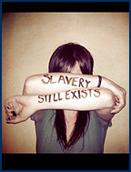
Victims of Trafficking & Slavery
Victims may not realise they are being exploited
Victims can be prevented from revealing their experience to authorities, due to fear, shame, language barriers and a lack of opportunity to do so.
It can take time for a person to feel safe enough to open up about their experiences

Slide 22
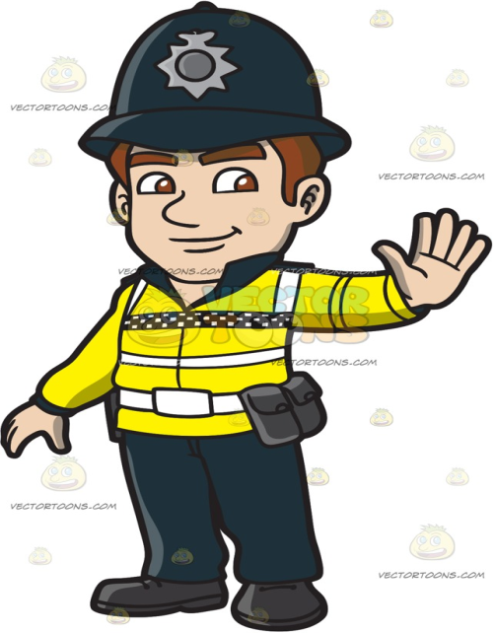
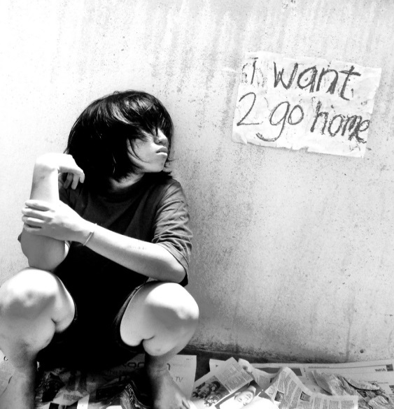
Victim Focused
PRIORITY - THE WELFARE OF VICTIMS:
Removal and safeguarding of the victim is the primary objective.
SECONDARY AIM –
The Prosecution of offenders
DO (Good Practice):
Think victim care and protection
Try to make the victim feel safe and supported
Try to dispel fears of the Police or authorities
Establish Trust and Rapport with the victim
Accept everything at face value

Slide 23
National Referral Mechanism (NRM)
The NRM is a NATIONAL framework for identifying victims of modern slavery / human trafficking and ensuring they receive the appropriate protection and support.
Support within the NRM is mandatory
The Modern Slavery Human Trafficking Unit (formally UK Human Trafficking Centre) at the National Crime Agency (NCA) receives the NRM forms for assessment.
The MSHTU 24 hour 7 days a week on call Tactical Advisors can assist officers in referring victims.
Adult MUST consent to be referred (if no consent, then Duty to Notify mechanism must be used – see later)
No consent is required to refer a child (under 18 years)

Slide 24
National Referral Mechanism (NRM)
First responders:
Police forces
UK Border Agency (The UK Visas & Immigration and Border Force)
Gangmasters & Labour Abuse Authority (GLAA)
Local Authorities
Listed Charities (Salvation Army, Poppy Project, Migrant Help, Medaille Trust, Kalayaan, Barnardos, Unseen, NSPCC (CTAC))
Single Competent Authority: until recently two agencies as below;
Modern Slavery Human Trafficking Unit at National Crime Agency (referrals from the police, local authorities and NGOs)
Home Office Immigration and Visas (referrals identified as part of the immigration process or asylum claim)
Now one agency

Slide 25
Duty to Report
Since 1st November 2015 public authorities have a duty to report all potential victims of Modern Slavery to Home Office either;
By NRM mechanism
Or Duty To Report process
This occurs where it is believed an adult is victim of Modern Slavery & declines to enter NRM
NB. Under 18’s; classified as children automatically entered into NRM

Slide 26
Assistance
Threat to life; 999
National Helpline run by UNSEEN : 0800 0121 700 https://www.unseenuk.org/
Nb. This helpline is for anybody; obviously victims, but can be used by professionals to seek advice. All operatives have 6 weeks training before they are allowed to answer the phone & have extensive knowledge of options for victims available. They also have a useful resource centre. Highly recommended.
2. Modern Slavery Website: https://www.gov.uk/government/collections/modern-slavery
3. Salvation Army confidential helpline; 0300 303 8151
4. www.crimestoppers-uk.org/‎

Slide 27
Further Guidance & Assistance
UNSEEN’S Modern Slavery Helpline App https://www.modernslaveryhelpline.org/about/unseen
The Safe Car Wash App https://www.theclewerinitiative.org/safecarwash;
Farm Work Welfare App https://www.theclewerinitiative.org/news/2020/7/14/farm-work-welfare-app-a-new-app-to-tackle-modern-slavery-in-rural-areas
Just Good Work App; ; A free mobile app to equip vulnerable UK jobseekers and workers but also a good reference for those dealing with such https://www.justgood.work
New Home Office First Responder training https://policingslavery.co.uk/FirstResponderTraining/
Nb. Regarding the last two above it has come to notice that some organisations may have a security issue with the last on their systems

Slide 28
Last Word
I hope you have found this interesting enough to encourage you to study the subject further. I have only scratched the surface
Lack of knowledge of the subject has been the biggest barrier to dealing with it
Simply; if MSHT is not recognised, victims cannot be helped & offenders cannot be tackled
Frontline workers from whatever agency need to recognise the issue & do something about it.
The community; if you suspect something please report it
There is so much that can be done by tackling this together!

